Slide 1
Make Illegal States Unrepresentable
… in JavaScript
Pavel Studený

Slide 2

How much does the beer cost?
{
id: ‘beer’
price: $5.30
free: true
}

Slide 3
Make illegal states unrepresentable!
interface FreeItem
{
id: string
}
interface PaidItem
{
id: string
price: number
}
{
id: ‘beer’
price: $5.30
}

Slide 4
Yaron Minsky, Ocaml, 2011
type connection_state =
| Connecting
| Connected
| Disconnected
type connection_info = {
state: connection_state;
server: Inet_addr.t;
last_ping_time: Time.t option;
last_ping_id: int option;
session_id: string option;
when_initiated: Time.t option;
when_disconnected: Time.t option;
}
type connecting = { when_initiated: Time.t; }
type connected = { last_ping : (Time.t * int) option; session_id: string; }
type disconnected = { when_disconnected: Time.t; }
type connection_state =
| Connecting of connecting
| Connected of connected
| Disconnected of disconnected
type connection_info = {
state : connection_state;
server: Inet_addr.t;
}

Slide 5
F#
public enum UserStatus { Active, Deleted }
public class User {
public string Name {
get; private set;
}
public UserStatus Status {
get; private set;
}
public DateTime? DeletionDate {
get; private set;
}
public List<Subscription> Subscriptions {
get; private set;
}
}
type ActiveUser = {
Name: string;
Subscriptions: Subscription list
}
type DeletedUser = {
Name: string;
DeletionDate: DateTime;
}
type User = | Active of ActiveUser | Deleted of DeletedUser

Slide 6

What if your language …
does not have non-scalar enums?
does not have enums?
does not have type control?

Slide 7
What if your language …
does not have non-scalar enums?
does not have enums?
does not have type control?
Then you have to wrap your values.

Slide 8
Monadic way to access data
public String getDrink (Optional<Dude> dude) {
return dude
.filter(dude -> dude.getAge() >= 18)
.flatMap(dude -> dude.getFavoriteBeer())
.orElse(“Cola")
}

Slide 9
You are using (almost) monads already
fetch(‘http://example.com/api/v1/beer’)
.then(r => {
if (!r.ok) throw new Error(r.statusText);
return r.json();
})
.then(processResponse)
.catch(showError);
function processResponse(json) {
…
}
function showError(err) {
…
}

Slide 10

github.com/pavelstudeny/representable-state
Wraps underlying data
get() / set(…)
Partly monadic approach
Declarative transitions

Slide 11
npm install representable-state
import { defState } from ‘representable-state’;
const ReadyState = defState(
'unloaded', 'loading', 'complete‘
);
const readyState = new ReadyState('unloaded');
readyState.when('unloaded', startLoading);

Slide 12
npm install representable-state
const ReadyState = defState(
'unloaded', 'loading', 'complete‘
);
const readyState = new ReadyState('unloaded');
switch (readyState.get()) {
case ‘unloaded’: …
}

Slide 13
Non-scalar values
import { defState, StateType } from ‘representable-state’;
class HttpOk extends StateType {
constructor(body) {…}
}
class HttpRedirect extends StateType {
constructor(url) { … }
}
class HttpError extends StateType {}
const HttpStatus = defState(HttpOk, HttpRedirect, HttpError);

Slide 14
Non-scalar values
httpResult.set(
new HttpRedirect(‘http://example.com’)
);
httpResult.when(HttpRedirect, navigateTo);

Slide 15
Transitions
const state = defState(
'loading', 'loaded', 'unloading‘
)
.transitions({
'loading': [ 'loaded' ],
'loaded': [ 'unloading' ]
})
.create('loading');
state.set('unloading');

Slide 16
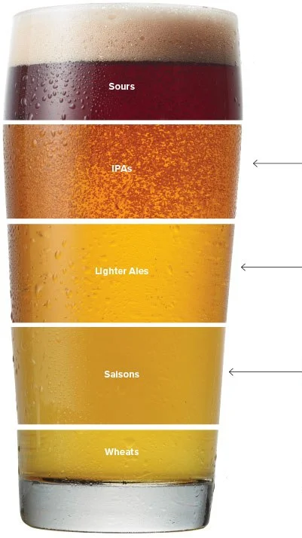
More features
nesting
intersections
default values

Slide 17


Slide 18
https://github.com/pavelstudeny/representable-state
Pavel Studený

